Slide 1
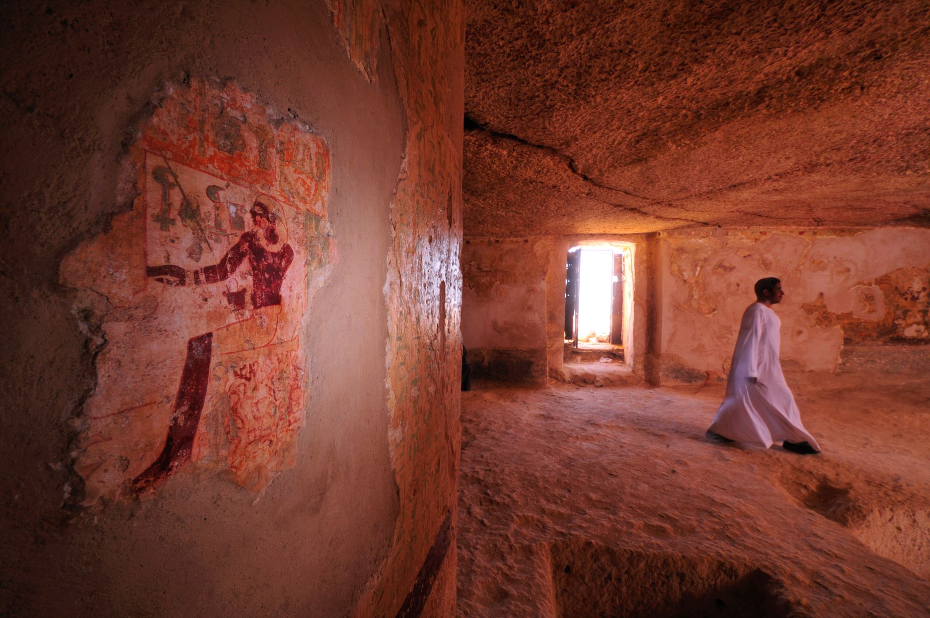
Job announcement at the American Research Center in Egypt (ARCE)
Position: Archives Assistant (Part-time)
Announcement Number: ARCE/24-04
Issue Date: 1 July 2024
Closing Date: 10 August 2024

Slide 2
About the American Research Center in Egypt (ARCE)
Founded in 1948, the American Research Center in Egypt (ARCE) is a private, nonprofit organization composed of educational and cultural institutions, professional scholars, and private individuals.
Through grants, fieldwork and field schools, ARCE’s partnership with Egyptians contributes to the shared goal of cultural heritage preservation. Over the years, ARCE’s strong relationship with the Ministry of Antiquities (MOA) (formerly the Supreme Council of Antiquities) has ensured the success of our work together.
Mission:
ARCE’s mission is to support research on all aspects of Egyptian history and culture; to protect, preserve and promote Egyptian cultural heritage; and to strengthen American-Egyptian cultural collaboration.
Vision:
ARCE plays a crucial role in preserving, understanding, and making accessible Egyptian cultural heritage in order to inform and enrich current and future generations.
Values:
Academic Excellence and Integrity: ARCE upholds standards of excellence in its endeavors and views integrity as an all-encompassing value that drives every aspect of its work.
Transparency: ARCE is committed to being transparent in operations and decision making.
Collaboration: ARCE builds collaborative partnerships with the Egyptian government, researchers, organizations and other stakeholders.
Inclusion, Diversity, Equity and Accessibility (IDEA): ARCE values engaging a wide community of individuals and organizations; actively promoting diversity and inclusion; and making its work accessible.
Sustainability: ARCE is committed to the principles of sustainability in its practices.
Innovation: ARCE seeks creative and innovative ways to enhance its work, broaden its scope and deepen its impact.

Slide 3
Qualifications
Bachelor’s degree in Archival Studies, Cultural Heritage Management, Information Science, or Digital Humanities OR equivalent work experience in a library or archival setting.
Proficiency in Microsoft office, Google Suite, and Adobe creative Cloud.
Fluency in English with excellent writing and verbal communication skills.
Experience in the utilization of various forms of specialized scanning equipment and image processing software.
Excellent research and problem-solving skills. Ability to concentrate and read numerous reports and edit.
Excellent research and problem-solving skills, including the ability to analyze, compare, evaluate, reconcile, and order data.
Highly motivated, organized, and detail-oriented individual with the ability to work independently.
Experience with cultural heritage institutions and/or a strong interest in cultural heritage management.
Skills and Duties
Responsibilities
Digitization of any non-digital material (such as documents, photographs, and drawings) using in-house equipment (scanners, DSLR camera).
Use Adobe Creative Cloud for image and documents processing.
Assess the quality of the finalized digitized data.
Prepare all files for ingestion and publication using established file name conventions, metadata standards, file formatting, etc. through file editing and/or metadata entry.
Conduct large-scale data preparation and data entry.
Maintain naming conventions and structure protocols.
Assist the Library and Archives Manager to prepare annual and final reports on project accomplishments.

Slide 4
To apply: Submit the following documentation:
1. A cover letter describing relevant experience and interest in the position.
2. A current curriculum vitae or resume.
3. The names of 2 professional references and their contact information.
Completed applications can be submitted with the subject line “Archives Assistant” to recruitment@arce.org
Reporting Relationship: This position reports to the Library and Archives Manager.
Eligibility for Consideration: Candidates must be legally permitted to work in Egypt.
Closing date for application to be considered is: 10 August 2024
Only short-listed applicants will be contacted.
Questions regarding the vacancy may be emailed to: recruitment@arce.org.
The American Research Center in Egypt is an Equal Opportunity Employer and is seeking a diverse slate of qualified candidates for formal consideration.

