Slide 1
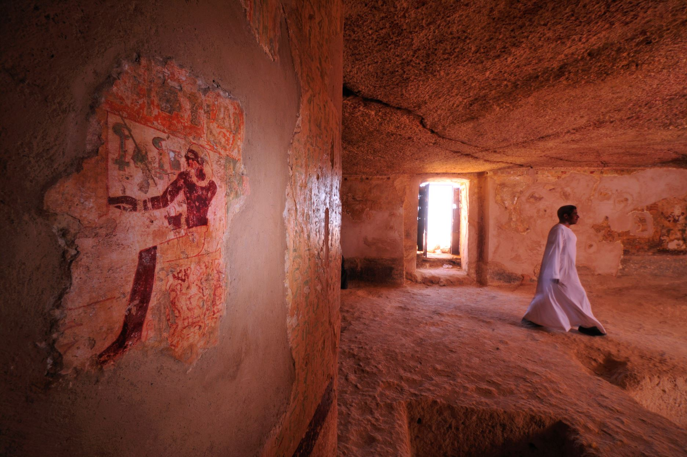
Job announcement at the American Research Center in Egypt (ARCE)
Position: Graphic Designer
Announcement Number: ARCE/23-08
Issue Date:
Closing Date:

Slide 2
About the American Research Center in Egypt (ARCE)
Founded in 1948, the American Research Center in Egypt (ARCE) is a private, nonprofit organization composed of educational and cultural institutions, professional scholars, and private individuals.
Through grants, fieldwork and field schools, ARCE’s partnership with Egyptians contributes to the shared goal of cultural heritage preservation. Over the years, ARCE’s strong relationship with the Ministry of Antiquities (MOA) (formerly the Supreme Council of Antiquities) has ensured the success of our work together.
Mission:
ARCE’s mission is to support research on all aspects of Egyptian history and culture; to protect, preserve and promote Egyptian cultural heritage; and to strengthen American-Egyptian cultural collaboration.
Vision:
ARCE plays a crucial role in preserving, understanding, and making accessible Egyptian cultural heritage in order to inform and enrich current and future generations.
Values:
Academic Excellence and Integrity: ARCE upholds standards of excellence in its endeavors and views integrity as an all-encompassing value that drives every aspect of its work.
Transparency: ARCE is committed to being transparent in operations and decision making.
Collaboration: ARCE builds collaborative partnerships with the Egyptian government, researchers, organizations and other stakeholders.
Inclusion, Diversity, Equity and Accessibility (IDEA): ARCE values engaging a wide community of individuals and organizations; actively promoting diversity and inclusion; and making its work accessible.
Sustainability: ARCE is committed to the principles of sustainability in its practices.
Innovation: ARCE seeks creative and innovative ways to enhance its work, broaden its scope and deepen its impact.

Slide 3
Qualifications
Degree in Bachelor’s Degree in Graphic Design or related field.
At least 5+ years of experience in graphic design. Previous experience in non-profit organizations is a plus.
Proficiency in Photoshop, InDesign and Illustrator including Adobe InDesign, Adobe InCopy up to Creative Cloud version 18, Adobe Creative Cloud, Microsoft office and Dropbox.
Strong Communication, conceptual thinking, typography and design skills.
Experience in briefing and dealing with agencies and print houses including offset publications.
Demonstrated sense of visual aesthetics, ability to produce graphic designs for advertisements and article page settings when required
Skills and Duties
Creative, organized and attentive to details.
Effective time management skills and ability to meet deadlines.
Prove trust to lead the art and design aspect of the Marketing and Communications department.
Seek to simplify any work process to improve efficiency and meet departments' design needs.
Highly motivated with the ability to work independently.
Respect the diversity of persons encountered in the daily work.
Responsibilities
Responsible for ARCE’s creative and visual strategy aspect of the Marketing and Communications department.
Responsible for maintaining ARCE’s branding guidelines and constantly improve communicated visuals.
Responsible for researching market trends and competition’s status to elevate the designs produced for ARCE while aligning to brand.
Responsible for all needed online visuals and POS material used by ARCE for programs, projects, events and collaborations.
Demonstrated sense of visual aesthetics, ability to produce graphic designs for advertisements and article page settings for magazines.
Responsible for defining requirements and creating designs from scratch for ARCE’s marketing collaterals including logos, illustrations, presentations and campaigns.
Responsible for meeting with staff members to discuss their requests and briefs.
Study design briefs and schedule projects based on priority in alignment with the Communications Manager.
Prepare rough drafts, present ideas, test graphics across various media, amend designs after feedback and ensure final graphics and layouts are visually appealing and on-brand.
Coordinate and follow up with colleagues, outside agencies, web designers, print houses as necessary both in Egypt and the U.S.

Slide 4
Projects
ARCE Templates:
Workshop, lecture and forum posters
Social media templates - including for ARCE’s 75th anniversary campaign
Development packages
One-pagers and presentations
The Annual Meeting:
Designing the full branding and all marketing collaterals including abstract booklet, sponsorship PDFs, posters, signage, invitations and giveaways to be ready before the month of April.
Cairo Conference:
Designing the full branding and all marketing collaterals including the logo, abstract booklet, sponsorship PDFs, posters, signage, invitations and giveaways to be ready before the month of November.
EOY Campaign:
Assisting the development department with all their design requirements for the campaign including letter, envelope and social media posts before the month of December.
Scribe:
Ability to devote around 100 hours to each issue of Scribe, with work running in two focused periods each year, from Jan 15th - March 1st for the spring issue and July 15th - 1st Sept for the fall issue.

Slide 5
How to Apply: To ensure consideration for this employment opportunity, applicants must reference the Announcement Number and Job Title in the subject line of an email in the following manner: ARCE/23-08, Graphic Designer to be emailed to Recruitment@ARCE.org. The application package should include an up-to-date CV, letter of interest, and photocopies of educational certifications (e.g. university transcripts, diplomas, certificates, etc.), portfolio (if available). Employment Reference letters are optional.
Reporting Relationship: This position reports to Marketing and Communication Manager
Eligibility for Consideration: Candidates must be legally permitted to work in Egypt.
Closing date for application to be considered is:
Only short-listed applicants will be contacted.
Questions regarding the vacancy may be emailed to: Recruitment@ARCE.org.
The American Research Center in Egypt is an Equal Opportunity Employer and is seeking a diverse slate of qualified candidates for formal consideration.

